Slide 1
Unleashing the Power of Data for Operational Excellence: Navigating Efficient Data Utilisation in Higher Education
36th ITS Integrator User Group Conference
Ntsundeni Louis Mapatagane

Slide 2
Presentation Outline
The Evolving Landscape of Higher Education
The Shift Towards Contextual Intelligence
Data-Driven Strategies for Operational Excellence
Navigating External Pressures with Data
Preparing for the Unknown: Data Systems for Future Challenges
Conclusion

Slide 3
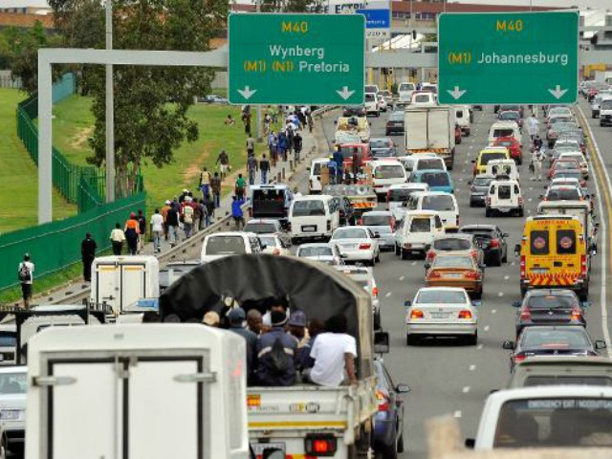
Background
‘to redress past inequalities and to transform the higher education system to serve a new social order, to meet pressing national needs and to respond to new realities and opportunities’ – National Plan for HE

Slide 4
The Evolving Landscape of Higher Education

Slide 5
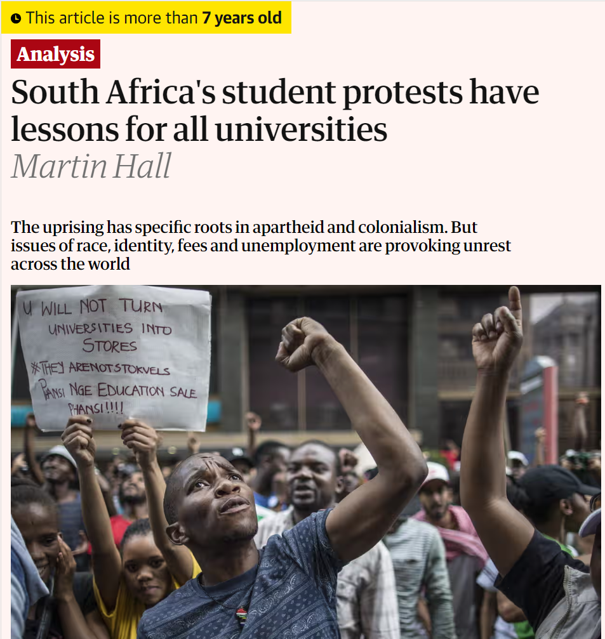
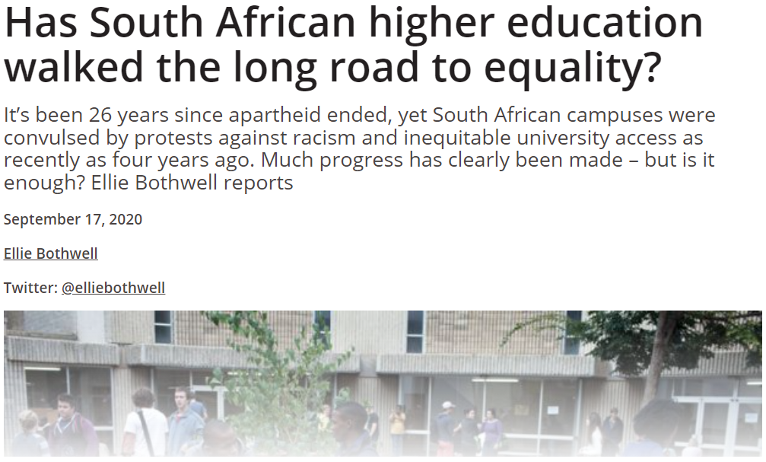
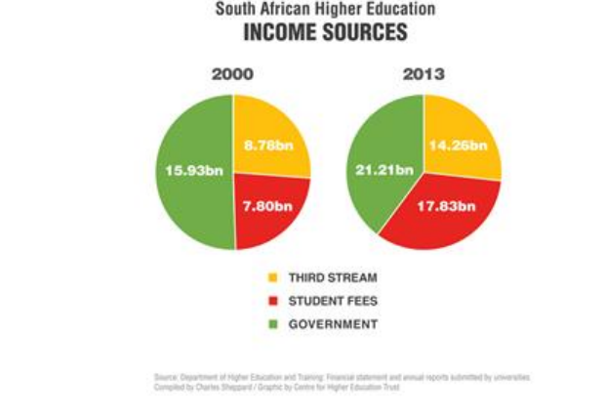
The Traditional Challenges
Notes:
The higher education sector has historically grappled with a range of internal challenges. These include the pursuit of academic excellence, the management of limited resources, and the need to meet the diverse needs of students. Institutions have strived to balance these demands while maintaining high standards of education and research. However, the landscape is shifting dramatically, demanding a reevaluation of these traditional focuses.

Slide 6
“The system as a whole has managed to navigate two decades of fundamental transition, unparalleled growth, extensive restructuring, funding constraints, greater reporting and compliance demands from an increasingly complex regulatory system, leadership challenges, governance concerns, student protests and more. It has demonstrated its robustness under extreme pressure and is arguably the strongest sector of the South African education system as a whole.”
Denyse Webbstock - South African higher education reviewed: Two decades of democracy (2016)

Slide 7
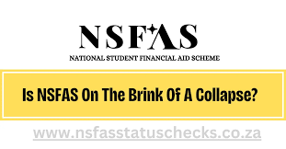
Emergence of External Pressures
Notes:
Today, we find ourselves navigating an increasingly complex environment, where external factors significantly impact the operational and strategic frameworks of higher education institutions. The influence of politics, the economy, globalization, and environmental concerns cannot be overstated. These elements introduce a level of volatility and uncertainty that was previously unanticipated, compelling institutions to look beyond their internal operations and consider the broader context in which they exist.

Slide 8
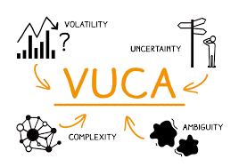
Understanding the VUCA Environment in the context of Higher Education
The acronym VUCA—standing for Volatility, Uncertainty, Complexity, and Ambiguity—aptly describes the current global landscape. Each component of VUCA presents unique challenges:
Volatility refers to the rapid and unpredictable nature of change, as seen in technological advancements and market fluctuations.
Uncertainty stems from the lack of predictability in issues such as political unrest and economic downturns.
Complexity involves the intertwined and complicated factors affecting higher education, including regulatory changes and international competition.
Ambiguity highlights the unclear and often misunderstood nature of future threats and opportunities.
These VUCA elements require higher education institutions to adopt a more agile and responsive approach to strategy and operations.

Slide 9
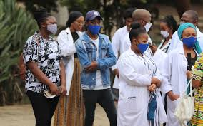
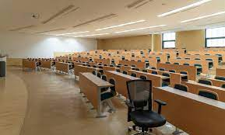
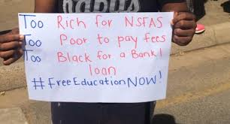
Shifting Focus to External Challenges
The challenges facing higher education today extend far beyond the confines of campus walls. Political decisions and economic policies can drastically alter funding models and student demographics. Globalization not only facilitates a more interconnected world but also brings competition and opportunities for collaboration. Environmental concerns, such as climate change, necessitate a rethinking of campus operations and curricula to prepare students for a sustainable future.
Case Examples of Disruption
Recent history provides stark examples of how external pressures can disrupt higher education:
#FeesMustFall
#Covid-19
Notes:
Case Examples of Disruption
Recent history provides stark examples of how external pressures can disrupt higher education:
• The #FeesMustFall movement in South Africa highlighted the impact of socio-political factors on accessibility and affordability of higher education.
• The COVID-19 pandemic revolutionized the sector by forcing a rapid shift to online learning, altering the student experience, and raising questions about the future of campus-based education.
• Environmental disasters and climate change are beginning to pose serious questions about campus safety, sustainability practices, and the role of universities in fostering environmental stewardship.
Conclusion
The evolving landscape of higher education demands a strategic pivot. Institutions must broaden their perspective to understand and respond to the external pressures shaping their environment. This requires not just an adaptation but a transformation in how we perceive the role of higher education in society. By acknowledging and addressing these external challenges, institutions can better prepare themselves for a future that is increasingly uncertain, complex, and interconnected.

Slide 10
The Shift Towards Contextual Intelligence
In response to the evolving landscape of higher education, characterized by the VUCA environment, a paradigm shift is underway. This shift moves us towards contextual intelligence—a strategic approach that emphasizes understanding and leveraging the broader context in which institutions operate. Contextual intelligence transcends mere data analysis; it involves synthesizing information from diverse sources, recognizing patterns, and applying insights in a way that is sensitive to the nuances of the external environment.

Slide 11
The Shift Towards Contextual Intelligence
Analytic/Technical Intelligence
Issues intelligence
Contextual Intelligence
Notes:
In response to the evolving landscape of higher education, characterized by the VUCA environment, a paradigm shift is underway. This shift moves us towards contextual intelligence—a strategic approach that emphasizes understanding and leveraging the broader context in which institutions operate. Contextual intelligence transcends mere data analysis; it involves synthesizing information from diverse sources, recognizing patterns, and applying insights in a way that is sensitive to the nuances of the external environment.

Slide 12
Notes:
The imperative for this shift is clear: traditional analytic and technical intelligence, while valuable, are no longer sufficient to navigate the complexities of today's higher education sector. Analytic intelligence focuses on understanding problems through data analysis and technical expertise, whereas issues intelligence concentrates on identifying and monitoring current trends and challenges. Contextual intelligence, however, demands a more holistic view. It requires integrating knowledge across different domains, considering historical, cultural, and socio-political factors, and anticipating future trends and disruptions.

Slide 13
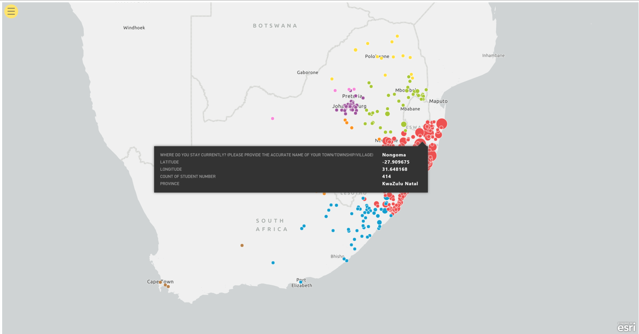

Slide 14
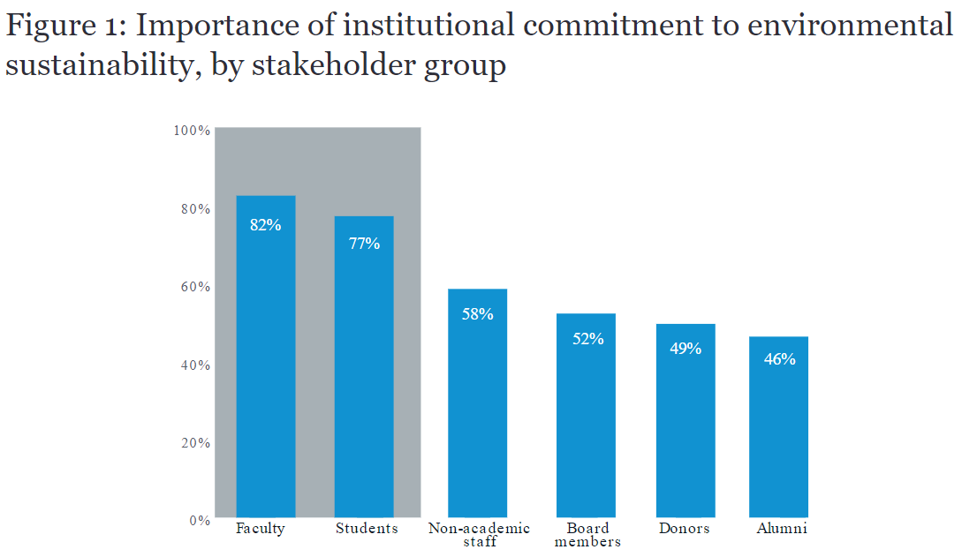
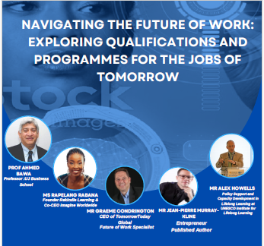
The Role of Contextual Intelligence in Addressing External Pressures
In the face of political and economic volatility, it allows institutions to adapt their funding models, explore alternative revenue streams, and advocate effectively for policy changes.
Amidst the challenges of globalisation, it enables institutions to identify strategic partnerships, attract international students, and offer globally relevant curricula.
As environmental concerns grow, contextual intelligence guides the development of sustainable campus operations and the integration of environmental stewardship into education and research.
Notes:
Moving Beyond Analytic/Technical and Issues Intelligence
The transition towards contextual intelligence represents a move from a reactive to a proactive stance. While analytic and technical intelligence equip us to respond to known challenges with precision, contextual intelligence prepares us for the unknown. It enables decision-makers in higher education to not only solve current problems but also to foresee potential issues and opportunities, thereby crafting strategies that are resilient, adaptive, and forward-looking.

Slide 15
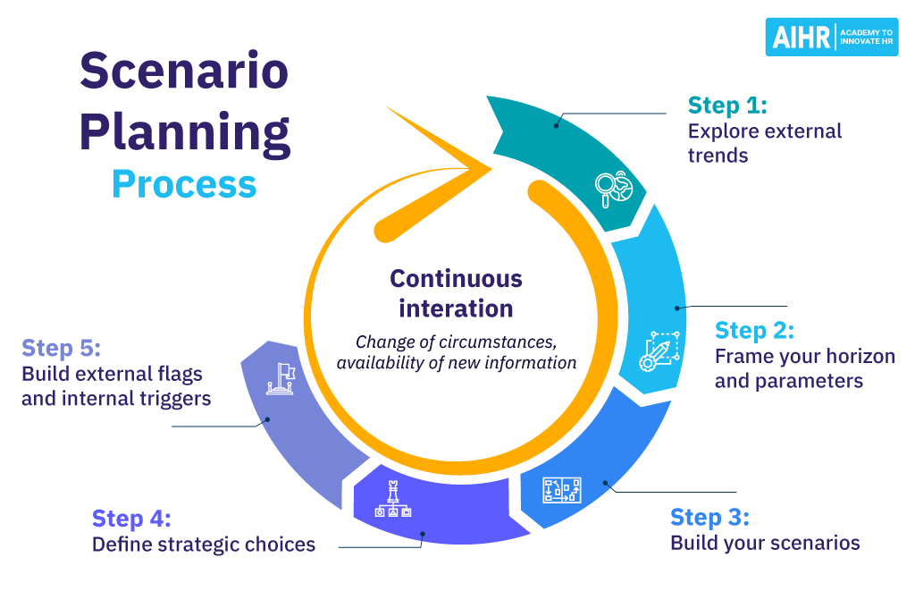
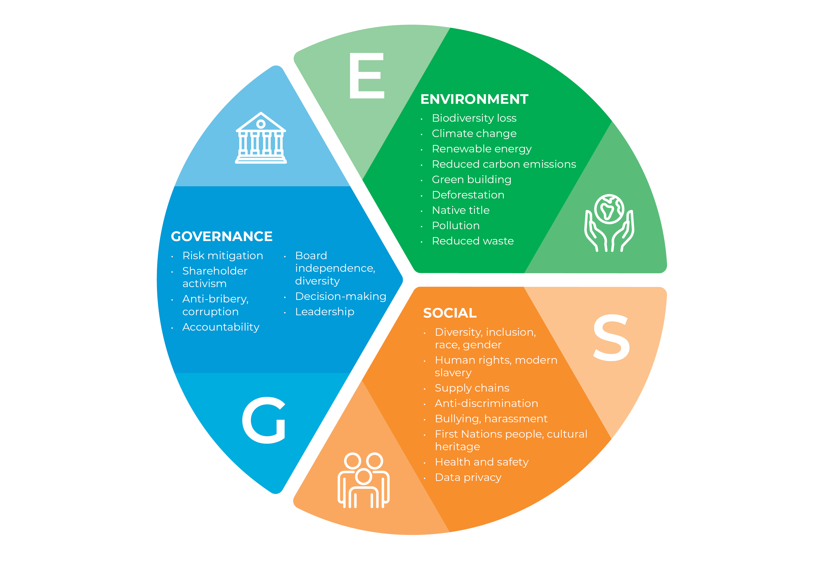
Contextual Intelligence in Action
Several institutions have already begun to harness the power of contextual intelligence:
Utilizing predictive analytics to anticipate shifts in student demographics and adapt recruitment strategies accordingly.
Engaging in scenario planning to prepare for various futures, from technological disruptions to changes in the regulatory landscape.
Implementing comprehensive sustainability initiatives that consider not just the environmental impact but also the economic and social dimensions of their operations.
The shift towards contextual intelligence in higher education is not just a strategic choice—it is a necessity. In a world marked by rapid change and deep interconnections, the ability to understand and act upon the broader context is what will differentiate successful institutions. By embracing contextual intelligence, higher education leaders can ensure their institutions are not only resilient in the face of external pressures but also capable of shaping the future of education in positive and impactful ways.
Notes:
Examples of Contextual Intelligence in Action
Several institutions have already begun to harness the power of contextual intelligence:
• Utilizing predictive analytics to anticipate shifts in student demographics and adapt recruitment strategies accordingly.
• Engaging in scenario planning to prepare for various futures, from technological disruptions to changes in the regulatory landscape.
• Implementing comprehensive sustainability initiatives that consider not just the environmental impact but also the economic and social dimensions of their operations.
Conclusion
The shift towards contextual intelligence in higher education is not just a strategic choice—it is a necessity. In a world marked by rapid change and deep interconnections, the ability to understand and act upon the broader context is what will differentiate successful institutions. By embracing contextual intelligence, higher education leaders can ensure their institutions are not only resilient in the face of external pressures but also capable of shaping the future of education in positive and impactful ways.

Slide 16
Data-Driven Strategies for Operational Excellence
Enhanced Decision-Making
Utilise data analytics to inform strategic planning and policy development. This includes analysing enrolment trends, student performance data, and financial models to make informed decisions that align with institutional goals and student needs.
Predictive Analytics for Student Success
Implement predictive analytics to identify students at risk of underperforming or dropping out. By analysing patterns in grades, attendance, and engagement, institutions can intervene early, offering targeted support to improve outcomes.
Operational Efficiency through Automation
Automate routine administrative tasks to improve efficiency and reduce errors. This can include everything from student admissions processes to scheduling and resource allocation, freeing up staff to focus on higher-value activities.
Enhancing the Student Experience
Use data to personalize the learning experience, adapting teaching methods and materials to meet the needs and preferences of individual students. This can lead to improved engagement, satisfaction, and academic success.
Facilitating Research and Innovation
Leverage data to identify emerging research trends and opportunities for innovation. This can help institutions stay at the forefront of their fields, attracting top faculty and students.
Notes:
Embracing Data-Driven Excellence
In an era defined by rapid technological advancement and shifting societal needs, higher education institutions must pivot towards data-driven strategies to achieve operational excellence. This means leveraging data not just for reporting and compliance, but as a strategic asset that informs decision-making, improves efficiency, and enhances the educational experience. Data-driven excellence involves collecting, analysing, and acting on data in ways that are proactive, predictive, and purposeful.

Slide 17
Challenges and Considerations
While the potential benefits of data-driven strategies are immense, institutions must navigate several challenges:
Data Quality and Accessibility: Ensuring data is accurate, complete, and accessible to those who need it.
Privacy and Security: Balancing the need for comprehensive data analysis with the imperative to protect sensitive information.
Cultural Change: Cultivating a data-informed culture that values evidence-based decision-making and continuous improvement.
Notes:
The shift towards data-driven strategies in higher education is not merely a trend but a critical evolution in how institutions operate and thrive. By harnessing the power of data, higher education institutions can achieve operational excellence, enhance the student experience, and navigate the complexities of the modern educational landscape with confidence. The journey towards data-driven excellence requires commitment, collaboration, and a willingness to embrace change, but the rewards—improved efficiency, effectiveness, and impact—are well worth the effort.

Slide 18
Navigating External Pressures with Data
Economic Forecasting and Scenario Planning
Profitability
Viability
Policy Impact and Analysis
Political decisions
Regulatory changes
Demographic Shifts and Access to Education
Address barriers to access and success
Targeted programmes and outreach
Notes:
Introduction to External Pressures
Higher education institutions are increasingly subject to a variety of external pressures that challenge traditional operational models and strategic priorities. These pressures include rapid technological changes, shifting global demographics, fluctuating economic conditions, and growing environmental concerns. Navigating these complexities requires a strategic approach that leverages data to anticipate, understand, and respond effectively.
Utilizing Data to Understand and Adapt to Political and Economic Changes
• Economic Forecasting and Scenario Planning: Institutions can use economic data and predictive modeling to forecast funding changes and plan for various economic scenarios. This approach allows for proactive budgeting and resource allocation, ensuring financial stability even in uncertain times.
• Policy Impact Analysis: Data analytics can help institutions assess the impact of political decisions and regulatory changes on their operations and strategic goals. By understanding these impacts, institutions can advocate for favorable policies and adapt their strategies accordingly.
Addressing Societal Changes with Data
Social Listening and Sentiment Analysis: By analyzing social media data and public sentiment, institutions can stay attuned to societal trends and concerns. This can inform community engagement strategies, program development, and campus culture initiatives.
Demographic Shifts and Access to Education: Data on demographic trends can help institutions understand and address barriers to access and success in higher education. Targeted programs and outreach can be developed to serve underrepresented communities better.

Slide 19
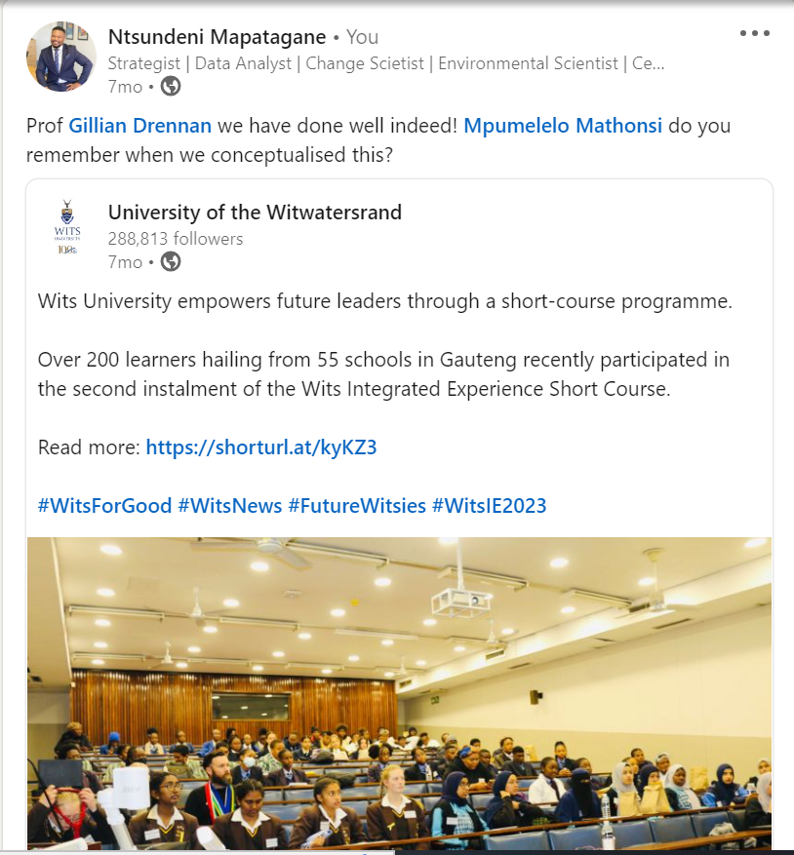
Notes:
Conclusion
In the face of external pressures, higher education institutions must leverage data not just to survive but to thrive. By utilizing data to understand and adapt to political, economic, global, and environmental changes, institutions can make informed decisions that ensure their resilience and relevance in a rapidly changing world. Navigating these pressures with data empowers institutions to proactively address challenges, seize opportunities, and fulfill their mission in serving students and society.

Slide 20
Preparing for the Unknown: Data Systems for Future Challenges
Building Anticipatory Data Systems
Future-proofing through Flexible Data Architecture: Designing data systems with adaptability in mind ensures that institutions can respond to new demands as they arise.
Predictive Analytics and Machine Learning: Leveraging advanced analytics and machine learning algorithms can help institutions identify patterns and trends that signal future challenges or opportunities.
Predictive Analytics and Machine Learning: Leveraging advanced analytics and machine learning algorithms can help institutions identify patterns and trends that signal future challenges or opportunities.
Enhancing Decision-Making with Contextual and Predictive Insights
Integrating External Data Sources: To navigate the complexities of the external environment, institutions must look beyond their internal data.
Developing a Culture of Data Literacy: Ensuring that decision-makers at all levels of the institution have the skills to interpret and act on data is crucial.
Addressing Ethical Considerations
Data Privacy and Security: POPIA
Bias and Fairness: Predictive models must be carefully designed to avoid perpetuating biases or unfairness.
Notes:
Embracing Uncertainty in Higher Education
The future of higher education is marked by unprecedented uncertainty, with emerging technologies, societal shifts, and global challenges reshaping the landscape. In this context, preparing for the unknown becomes a strategic imperative. Institutions must develop data systems that are not only robust and flexible but also capable of anticipating future challenges and harnessing opportunities that have yet to emerge.

Slide 21
Notes:
Conclusion
Preparing for the unknown requires higher education institutions to think creatively and strategically about their data systems. By building flexible, anticipatory, and ethically governed data infrastructures, institutions can position themselves to navigate future challenges with confidence. The goal is not just to respond to the changes that the future holds but to shape the future of education itself, leveraging data to create a more adaptable, responsive, and impactful higher education sector.

Slide 22
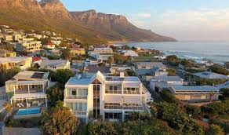
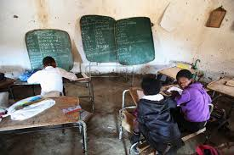
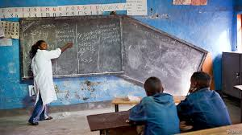
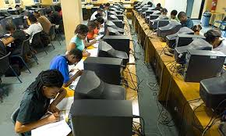
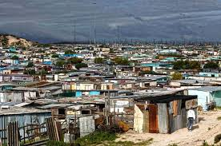

Slide 23
Conclusion
As we conclude our exploration into "Unleashing the Power of Data for Operational Excellence: Navigating Efficient Data Utilization in Higher Education," it is clear that the journey towards data-driven excellence is both a challenge and an opportunity. The evolving landscape of higher education, marked by external pressures and the imperative for operational excellence, necessitates a strategic shift towards embracing data as a fundamental asset.

Slide 24
The Path Forward
A commitment to building robust data systems, fostering a culture of data literacy, and leveraging data for strategic decision-making. It is through these efforts that higher education institutions can navigate the complexities of the modern educational environment, adapt to changing circumstances, and proactively prepare for the future.
Call to Action
Invest in Data Infrastructure: Prioritize investments in data infrastructure that supports flexible, comprehensive, and secure data analysis and storage
Cultivate Data Literacy: Developing a culture of data literacy across all levels of the institution is crucial.
Leverage Predictive Analytics: Institutions should harness the power of predictive analytics to anticipate future trends, identify opportunities for innovation, and mitigate potential risks.
Adopt Ethical Data Practices: Ethical considerations in data collection, analysis, and use cannot be overstated.
Engage in Continuous Learning and Improvement: The journey towards data-driven excellence is ongoing.
Notes:
In an era characterized by rapid change and increasing complexity, the strategic utilization of data stands as a beacon of hope for higher education institutions striving for operational excellence and impactful education. By embracing data-driven strategies, institutions can enhance their resilience, adaptability, and effectiveness, ultimately ensuring their continued relevance and success in the face of future challenges.
Let us take this call to action to heart, committing ourselves to the transformative power of data in higher education. Together, we can navigate the complexities of the modern educational landscape and shape a future that reflects our highest aspirations for efficiency, impact, and excellence in higher education.

Slide 25
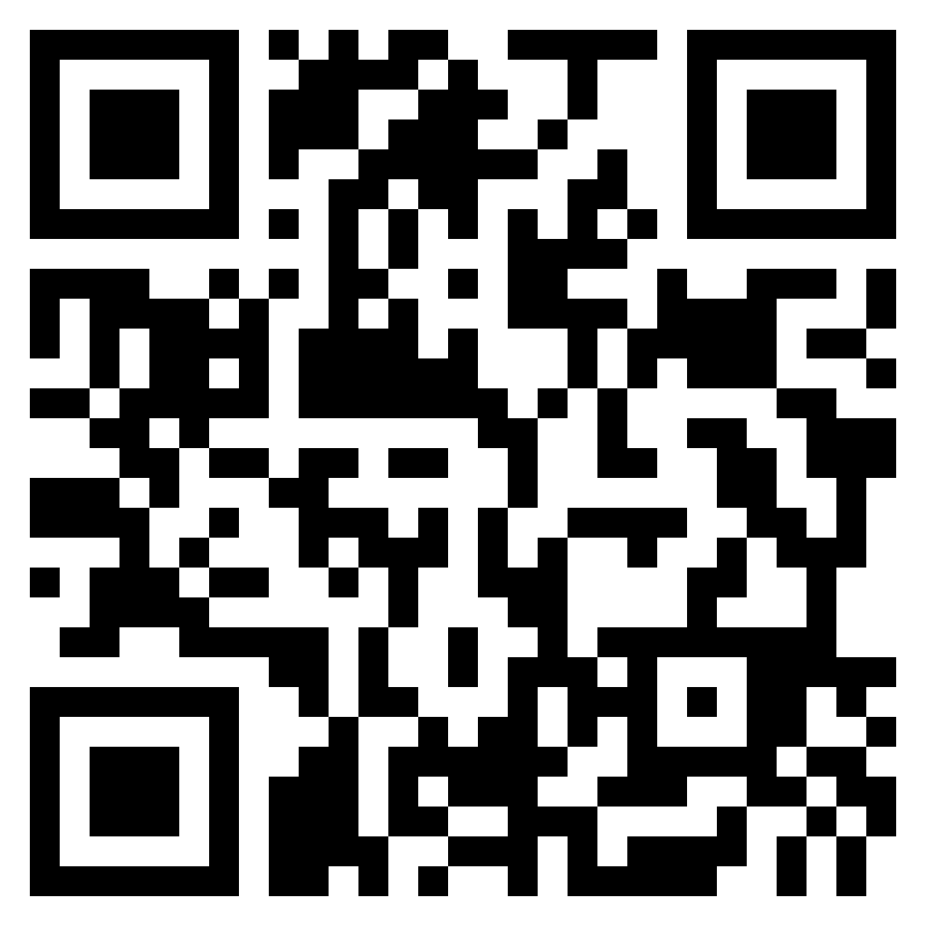
Thank you!
Ndo livhuwa, Enkosi, Na khensa, Dankie, Ngiyabonga, Kea legoha

